Slide 1
CS - 571
Database Systems for BS (CS)
Lecture: Practice Questions
Dr. Khurram Shahzad
khurram@pucit.edu.pk
Punjab University College of Information Technology

Slide 2
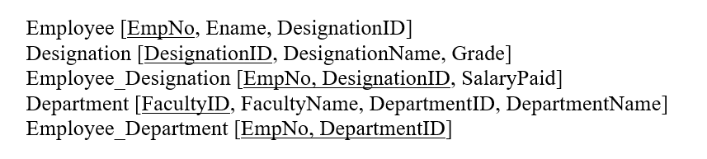
Select Command
Find the designation names whose grades are not yet assigned.

Slide 3
Select Command
Find the designation names whose grades are not yet assigned.
Select Designation
From Designation
Where Grade is NULL

Slide 4
Select Command
How much would be the salary each employeeID, if the salary he receives is doubled.

Slide 5
Select Command
How much would be the salary of each employee whose ID is above 100, if the salary he receives is doubled.
Select SalaryPaid*2 Double_Salary
From Employee_Designation
Where Employee > 100;

Slide 6
Select Command
Show the names of employees and their designation in the following format. Khurram is working as Assist Prof

Slide 7
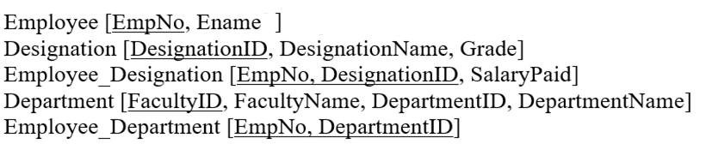
Select Command
Show the Names and designation of the employees who are Lecturers, Assistant Professor or Associate Professor.

Slide 8
Select Command
Show the Names and designation of the employees who are Lecturers, Assistant Professor or Associate Professor.
Select Ename, DesignationName
From Employee E, Designation D, Employee_Designation ED
Where E.EmpNo = ED.EmpNo
AND ED.EmpNo = DesignationID
Where DesignationName IN (‘Lectures’, ‘Assistant Professor’, ‘Associate Professor’);

Slide 9
Select Command
Show the Department names of the employees, whose salaries are between 100,000 and 200,000.

Slide 10
Select Command
Show the Department names of the employees, whose salaries are between 100,000 and 200,000.
Select DepartmentName
From Department D, Employee_Department ED, Employee E, Employee_Designation EmpD, Designation DES
Where D.DepartmentID = ED.DepartmentID
AND ED.EmpNo = E.EmpNo
And E.EmpNo = DES.DesignationID …
AND SalaryPaid Between 100,000 and 200,000;

Slide 11
Select Command
Show the names of the employees whose names start with K.

Slide 12
Select Command
Show the names of the employees whose names start with K.
Select EName
From Employee
Where Ename like ‘K%’

Slide 13
Select Command
Compute the total salary paid by the institute each year.

Slide 14
Select Command
Compute the total salary paid by the institute each year.
Select Sum(SalaryPaid*12)
From Employee_Designation

Slide 15
Select Command
Compute the total salary paid by the each department of the institute along with the department name.

Slide 16
Select Command
Compute the total salary paid by the each department of the institute along with the department name.
Select DepartmentName, Sum(SalaryPaid*12)
From Department D, Employee_Department ED, Employee E, Employee_Designation EMPD
Where D.DepartmentID = ED.EmpNO
AND E. EmpNo = ED.EmpNo
AND Desig.DesignatoinID = E.EmpNo
Group by Department ID / DepartmentName;

Slide 17
Select Command
Generate the list of all employees their respective designations and all designations.

Slide 18
Select Command
Generate the list of all employees (names only) their respective designations and all designations (names only).
Select Ename, DesignationName
From Employee E, Employee_Designation ED, Designation D
Where E. EmpNo = ED.EmpNo (+)
AND ED.DesignatoinID = D.DesignationID (+);

